Slide 1



Lecture 05: A primer on network security
COMP260: Game Architecture
BSc Computing for Games

Slide 2
Today’s lecture:
Definition of terms
Internet-enabled vs. Internet-centric organisations
Passwords

Slide 3
Definition of terms

Slide 4
Definition of terms
Key terms:
Vulnerability
Threat
Attack

Slide 5
Definition of terms
Key terms:
Vulnerability
A component of a network and/or process that leaves a system open to exploitation
Physical issues
Protocol issues
Staff issues
Process issues
Customer issues
Threat
Attack

Slide 6
Definition of terms
Key terms:
Vulnerability
A component of a network and/or process that leaves a system open to exploitation
Physical issues
Location of computers, routers, cables, access points and so on
Physical assets can be compromised / taken / lost
Common to see portable devices (laptops / usb devices) ‘lost’, left behind or stolen
https://www.theguardian.com/politics/2008/jun/12/defence.terrorism
China infiltrating US firms through motherboard hacks
https://www.bloomberg.com/news/features/2018-10-04/the-big-hack-how-china-used-a-tiny-chip-to-infiltrate-america-s-top-companies
Data has significant value!
Protocol issues
Staff issues
Process issues
Customer issues
Threat
Attack

Slide 7
Definition of terms
Key terms:
Vulnerability
A component of a network and/or process that leaves a system open to exploitation
Physical issues
Protocol issues
Protocols are open formats (as providers need to be able to see what they are to implement them)
Protocol data can be captured / copied and decoded
Staff issues
Process issues
Customer issues
Threat
Attack

Slide 8
Definition of terms
Key terms:
Vulnerability
A component of a network and/or process that leaves a system open to exploitation
Physical issues
Protocol issues
Staff issues
Staff may use weak passwords, leave passwords in plain sight
Staff may be hoodwinked into revealing passwords / sensitive data
Staff may be coerced into revealing passwords / sensitive data
Disgruntled staff may reveal passwords / sensitive data for malevolent ends
Process issues
Customer issues
Threat
Attack

Slide 9
Definition of terms
Key terms:
Vulnerability
A component of a network and/or process that leaves a system open to exploitation
Physical issues
Protocol issues
Staff issues
Process issues
Organisations may have approaches that leave them vulnerable:
Weak passwords as company policy
Poor protocol / networking approaches (HTTP vs. HTTPS, unencrypted packet data)
Poor data management policies (unencrypted customer data & company data)
Poor data disposal policies (not wiping drives on PCs, usb etc)
Data centre security issues
Customer issues
Threat
Attack

Slide 10
Definition of terms
Key terms:
Vulnerability
A component of a network and/or process that leaves a system open to exploitation
Physical issues
Protocol issues
Staff issues
Process issues
Organisations may have approaches that leave them vulnerable:
Weak passwords as company policy
Poor protocol / networking approaches (HTTP vs. HTTPS, unencrypted packet data)
Poor data management policies (unencrypted customer data & company data)
Poor data disposal policies (not wiping drives on PCs, usb etc)
Data centre security issues
Customer issues
Weak passwords / shared passwords
Using shared machines
Poor wifi choices (man in the middle ‘coffee shop’)
Overly trusting attitude / greed (phising / boiler rooms)
Threat
Attack

Slide 11
Definition of terms
Key terms:
Vulnerability
Threat
The potential for a violation of security
Natural disasters
Insiders or malicious and disgruntled employees
Hackers
Non-malicious employees
Users
Attack

Slide 12
Definition of terms
Key terms:
Vulnerability
Threat
Attack
An attempted violation
Attack = vulnerability + method + threat + motive

Slide 13
Definition of terms
Key terms:
Vulnerability
Threat
Attack
An attempted violation
Attack = vulnerability + method + threat + motive
Motives:
LoLs / Demonstrate skill
need to find / share information
Blackmail / financial
Acquire resources
Physical cpu / storage / networking
Users / user data

Slide 14
Definition of terms
Types of attack
Passive
Active

Slide 15
Definition of terms
Types of attack
Passive
Traffic analysis
Where are packets going to?
Reading content
What is in packets?
Active

Slide 16
Definition of terms
Types of attack
Passive
Active
Credential mis-use
Stolen account details
Acquired account details
‘Cracked’ account details
Packet fabrication
Message replay
Message modification
Message spamming (DDoS attacks)

Slide 17
Definition of terms
Escalation of security breaches
LOLs
Solo / team hackers demonstrate their ‘value’
Digital / political hacktivism
Financial gain
Blackmail
Building botnets

Slide 18
Definition of terms
Escalation of security breaches
LOLs
Generally low-impact issues where accounts will be hacked for amusement, rather than serious consideration
Social media spoof posts
Comedy emails
etc
Solo / team hackers demonstrate their ‘value’
Digital / political hacktivism
Financial gain
Blackmail
Building botnets

Slide 19
Definition of terms
Escalation of security breaches
LOLs
Solo / team hackers demonstrate their ‘value’
Hackers break in to (typically) US government servers to
illustrate weaknesses in security (white hatters)
Look for UFO evidence / whistle blowing
Generally get extradited to US to face long charges
Laurie Love http://www.bbc.co.uk/news/uk-england-suffolk-42166200
Gary McKinnon https://en.wikipedia.org/wiki/Gary_McKinnon
Marcus Hutchins https://krebsonsecurity.com/2017/09/who-is-marcus-hutchins/
Digital / political hacktivism
Financial gain
Blackmail
Building botnets

Slide 20
Definition of terms
Escalation of security breaches
LOLs
Solo / team hackers demonstrate their ‘value’
Digital / political hacktivism
Defined as ‘subversive use of computers and networks to promote a political agenda or social change
https://techcrunch.com/2017/02/22/the-dramatic-rise-in-hacktivism/
http://www.computerweekly.com/opinion/Hacktivism-Good-or-Evil
Can be government organised
http://fortune.com/2017/12/11/russian-hacking-election-confession/
https://www.theguardian.com/technology/2017/oct/23/kaspersky-lab-security-firm-win-trust-russian-spying-scandal-antivirus
Financial gain
Blackmail
Building botnets

Slide 21
Definition of terms
Escalation of security breaches
LOLs
Solo / team hackers demonstrate their ‘value’
Digital / political hacktivism
This is spying / activism in the 21st century
Evidence of politically motivated DDoS attacks to bring down services
Hacking Isis Twitter accounts
Defacing websites
Also commercial
https://www.networkworld.com/article/2998251/malware-cybercrime/sony-bmg-rootkit-scandal-10-years-later.html
Financial gain
Building botnets

Slide 22
Definition of terms
Escalation of security breaches
LOLs
Solo / team hackers demonstrate their ‘value’
Digital / political hacktivism
Use of Facebook data to target Brexit / US Election voting
https://www.thedrum.com/news/2019/01/15/pro-brexit-ads-throw-spotlight-facebook-s-political-ad-transparency-pledge
https://www.theguardian.com/uk-news/2018/nov/06/arron-banks-firm-and-leave-eu-face-135k-fine-over-data-misuse
https://www.theguardian.com/politics/2018/nov/02/arron-banks-inquiry-why-is-8m-leaveeu-funding-under-review
https://www.theguardian.com/uk-news/2018/mar/23/leaked-cambridge-analyticas-blueprint-for-trump-victory
Financial gain
Building botnets

Slide 23
Definition of terms
Escalation of security breaches
LOLs
Solo / team hackers demonstrate their ‘value’
Digital / political hacktivism
Financial gain
Strong driver for any illegal activities -> £££
Fraudulent transactions / Identity theft
Phishing: http://www.phishing.org/common-phishing-scams
Building botnets

Slide 24
Definition of terms
Escalation of security breaches
LOLs
Solo / team hackers demonstrate their ‘value’
Digital / political hacktivism
Financial gain
Ransomware
Encrypting user data and charging a fee to decrypt
https://www.tripwire.com/state-of-security/security-data-protection/cyber-security/10-significant-ransomware-attacks-2017/
Blackmail
Building botnets

Slide 25
Definition of terms
Escalation of security breaches
LOLs
Solo / team hackers demonstrate their ‘value’
Digital / political hacktivism
Financial gain
Selling sensitive data
Typically email addresses / credit card details taken from organisations:
https://www.theguardian.com/technology/2016/dec/14/yahoo-hack-security-of-one-billion-accounts-breached
https://siliconangle.com/blog/2017/12/31/forever-21-confirms-credit-card-details-stolen-hack-sales-network/
Blackmail
Building botnets

Slide 26
Definition of terms
Escalation of security breaches
LOLs
Solo / team hackers demonstrate their ‘value’
Digital / political hacktivism
Financial gain
Blackmail
Acquiring ‘compromising’ information
Webcam blackmail:
https://www.getsafeonline.org/social-networking/webcam-blackmail/
Organisational blackmail:
https://www.forbes.com/sites/davelewis/2014/11/24/sony-pictures-hacked-and-blackmailed/#58e58f0d42b2
Building botnets

Slide 27
Definition of terms
Escalation of security breaches
LOLs
Solo / team hackers demonstrate their ‘value’
Digital / political hacktivism
Financial gain
Blackmail
Building botnets
Intrinsic value of computer cpu, gpu, memory & network resources
Compromising PCs with software to
co-ordinate DDoS attacks
bitcoin mining ;)
Torrent hosts
Email farms

Slide 28
Internet-enabled vs. Internet-centric organisations

Slide 29
Internet-enabled vs. Internet-centric organisations
We live in an internet protocol age
Not all individuals and organisations have the same need or use of the internet:
Internet-enabled organisations
Organisations that use the internet for non-critical business activities
Internet-centric organisations
Organisations whose business is predicated by the internet

Slide 30
Internet-enabled vs. Internet-centric organisations
We live in an internet protocol age
Not all individuals and organisations have the same need or use of the internet:
Internet-enabled organisations
Organisations that use the internet for non-critical business activities
Banks with online banking
Bricks and mortar shops with online shopping channels
Offline companies with a web marketing presence (website, social media etc)
Traditional products with IP components (IoT enabled toaster)

Slide 31
Internet-enabled vs. Internet-centric organisations
We live in an internet protocol age
Not all individuals and organisations have the same need or use of the internet:
Internet-enabled organisations
Risk for these companies is that network security / IP understanding isn’t necessarily core to their business culture
Hackers will target these firms
For the LoLs
To prove they can
For hacktivism
For profit
For their computing resources

Slide 32
Internet-enabled vs. Internet-centric organisations
We live in an internet protocol age
Not all individuals and organisations have the same need or use of the internet:
Internet-centric organisations
Organisations whose business is predicated by the internet
Social media companies (Twitter, FB, blogging)
Purely on-line stores and services (Amazon, ebay, Steam)
GaaS (WoW, Clash of Clans etc)
Technology service providers (github, trello, teamviewer, google, yahoo etc)

Slide 33
Internet-enabled vs. Internet-centric organisations
We live in an internet protocol age
Not all individuals and organisations have the same need or use of the internet:
Internet-centric organisations
Risk for these organisations is that their entire business is (generally) predicated around being secure
Being insecure suggests an existential issue
Hackers will target these firms
For the LoLs
To prove they can
For hacktivism
For profit
For their computing resources

Slide 34
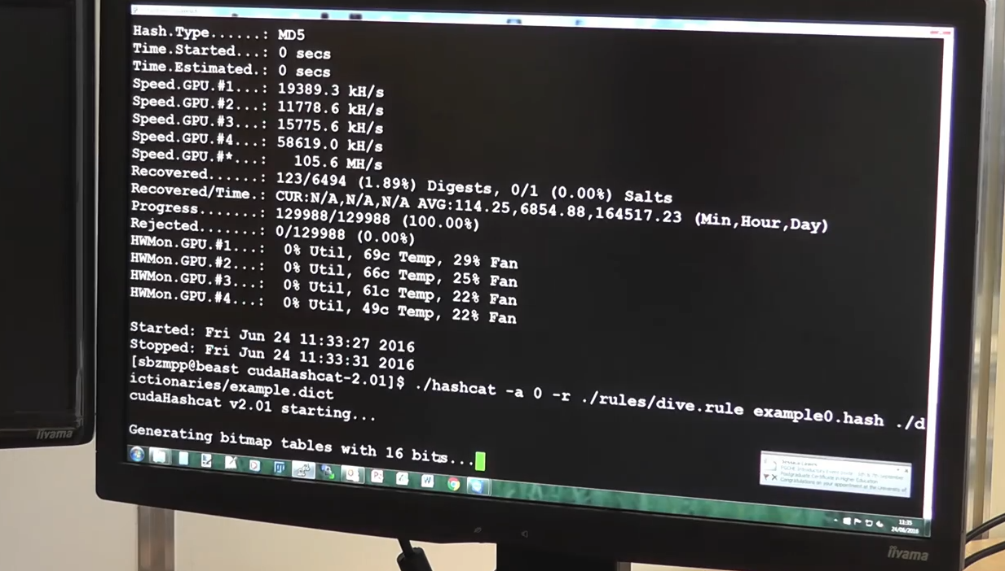
Passwords
A short video on why your passwords are terrible

Slide 35
Conclusions

Slide 36
Conclusions
‘Hackers’ want to get into computer systems as the system have inherent value
Financial value
Value of data
Value of visibility / eyeballs
Value of accomplishment

Slide 37
Conclusions
Generally with security, human factors are the weakest and easiest to exploit
Employees and users have their own needs that are not always aligned to good security
Ease of use vs. strength of security
Easy to remember passwords vs. Strong passwords
Storing vs. Remembering
Sharing vs. Security
2FA is a pain if you are in a poor mobile area
In transaction checks ‘slow’ people down
People assume the best of intentions
Ideal for phishers

Slide 38
Questions?

